Slide 1
Agenda:
Biblical Word Study
Chapter 10: Lifespan Development

Slide 2
Psalm 92:12-15
¹² The righteous will flourish like a palm tree, they will grow like a cedar of Lebanon; ¹³ planted in the house of the Lord, they will flourish in the courts of our God. ¹⁴ They will still bear fruit in old age, they will stay fresh and green, ¹⁵ proclaiming, “The Lord is upright; he is my Rock, and there is no wickedness in him.”
Video: Annie Murphy Paul: What we learn before we're born
http://www.ted.com/talks/annie_murphy_paul_what_we_learn_before_we_re_born.html

Slide 3

An Introduction to Psychological Science
Third Canadian Edition
Chapter 10
Lifespan Development
Slide in this Presentation Contain Hyperlinks. JAWS users should be able to get a list of links by using INSERT+F7
Copyright © 2021 Pearson Canada, Inc.
Notes:
If this PowerPoint presentation contains mathematical equations, you may need to check that your computer has the following installed:
1) MathType Plugin
2) Math Player (free versions available)
3) NVDA Reader (free versions available)

Slide 4

Modules
10.1: Physical Development from Conception through Infancy
10.2: Infancy and Childhood: Cognitive and Emotional Development
10.3: Adolescence
10.4: Adulthood and Aging
Leungchopan/Fotolia

Slide 5
10.1 Learning Objectives
Know the key terminology related to prenatal and infant physical development.
Understand pros and cons to different research designs in developmental psychology.
Apply your understanding to identify the best ways expectant parents can ensure the health of their developing fetus.
Analyze the effects of preterm birth.
Notes:
Know the key terminology related to prenatal and infant physical development.
See the bold, italicized terms below.
Understand the pros and cons to different research designs in developmental psychology.
Cross-sectional designs, in which a researcher studies a sample of people at one time, have the advantage of being faster, and generally cheaper, allowing research to be completed quickly; however, they may suffer from cohort effects, because people of different ages in the sample are also from somewhat different historical time periods and thus, any differences between them could reflect a historical process and not a developmental one. Longitudinal designs, in which a researcher follows a sample of people over a span of time, have the advantage of being able to track changes in the same people, thus giving more direct insight into developmental processes. However, such studies take longer to complete, thus slowing down the research process, and they can suffer from attrition, in which people drop out of the study over time.
Apply your understanding to identify the best ways that expectant parents can ensure the health of their developing fetus.
The key to healthy fetal development is ensuring a chemically-ideal environment. The most important factors are adequate nutrition and avoiding teratogens. Best nutritional practices include approximately a 20% increase in the mom's caloric intake, additional protein, and ensuring sufficient quantities of essential nutrients, which usually involves taking nutritional supplements. Avoiding teratogens involves giving up smoking and drinking alcohol, and getting good medical advice concerning any medications that the expectant mother may be taking.
Analyze the effects of preterm birth.
Children born very premature (25 weeks versus the normal 37 weeks) are at an increased risk for health problems. Use of personalized care, that emphasizes mother-infant contact, breastfeeding, and minimal sensory stimulation for the underdeveloped brain, increases the chances that preterm infants will remain healthy. Long-term studies indicate that with proper care, children born preterm will not be disadvantaged compared to peers born at normal term.

Slide 6
Developmental Psychology
Developmental psychology (p. 362)
Early development influences later behaviours
Notes:
1) The subfield of developmental psychology is essential because we do not enter the world as adults.
i) Also, much of what occurs through early development influences behaviour throughout the lifespan.
Developmental psychology (p. 362) is the study of human physical, cognitive, social, and behavioural characteristics across the lifespan.

Slide 7
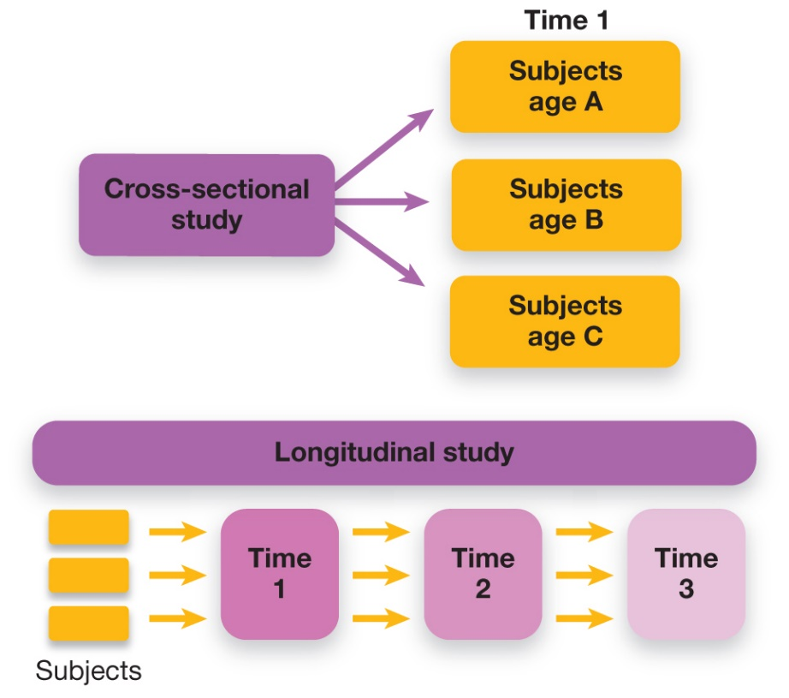
Methods for Measuring Developmental Trends
Figure 10.1 Cross-Sectional and Longitudinal Methods
In cross-sectional studies, different groups of people—typically of different ages—are compared at a single point in time. In longitudinal studies, the same group of subjects is tracked over multiple points in time.
Notes:
1) Developmental psychologists usually use a couple different designs for measuring how psychological traits and abilities change over time (Figure 10.1).
i) If you wanted to design a study examining the effects of premature birth on learning abilities from infancy through adulthood, you might compare people of different age group (e.g., 1, 5, 10, and 20-year-olds) using a cross-sectional design.
a) This design is convenient in terms of time and cost.
Cross-sectional design (p. 363) is used to measure and compare samples of people at different ages at a given point in time.
ii) In contrast, you would use a longitudinal design if you picked 50 infants and measured their cognitive development yearly over the course of 20 years.
Longitudinal design (p. 363) follows development of the same set of individuals through time.
a) Longitudinal studies take a lot of time and money.
b) This studies also suffer from attrition, which occurs when participants drop out.
c) A major advantage of longitudinal designs is the avoidance of group differences, such as those in cross-sectional designs.
2) On major issue to consider in cross-sectional designs is the potential for cohort effects.
i) Cohort and generation are similar things in this context.
Cohort effects (p. 363) are differences between people that result from being born in different time periods.
ii) A number of factors (e.g., societal, nutritional, medical, etc.) can influence physical and behavioural development across different age groups.
a) For example, in studying premature infants, medical care is very different now than it was 20 years ago.
Long Description:
The chart explains the studies by way of tree-diagrams as follows.
Cross-sectional study at Time 1
Subjects age “A”
Subjects age “B”
Subjects age “C”
Longitudinal study: The chart shows 3 subjects passing through “Time 1”, “Time 2”, and “Time 3.”

Slide 8
Patterns of Development: Stages and Continuity
Stages
Abrupt transitions
Continuous
Slow changes
Notes:
1) One view is that development happens in stages, a progression of abrupt transitions in physical or mental skills, followed by slower, more gradual change.
i) Transition from stage to stage is similar to a growth spurt, marked by rapid shifts in thinking and behaving.
a) These stages represent a fundamental shift in the type of abilities.
b) This understanding can be seen in developmental milestones of motor development (crawling, standing, walking; Module 10.2).
2) Another view is that development happens as a continuous change, at a slower, steady pace.
i) Adults are more likely to see slow changes in their physical and mental abilities vs. rapid shifts.
a) However, there are still stages in adulthood, such as marriage, parenthood, and retirement (Module 10.4).

Slide 9
Zygotes to Infants: From One Cell to Billions
Table 10.1 Phases of Prenatal Development
A summary of the stages of human prenatal development and some of the major events at each.
Germinal: 0 to 2 weeks
Major Events Migration of the blastocyst from the fallopian tubes and its implantation in the uterus. Cellular divisions take place that eventually lead to multiple organ, nervous system, and skin tissues.
Embryonic: 2 to 8 weeks
Major Events Stage in which basic cell layers become differentiated. Major structures such as the head, heart, limbs, hands, and feet emerge. The embryo attaches to the placenta, the structure that allows for the exchange of oxygen and nutrients and the removal of wastes.
Fetal stage: 8 weeks to birth
Major Events Brain development progresses as distinct regions take form. The circulatory, respiratory, digestive, and other bodily systems develop. Sex organs appear at around the third month of gestation.
Top: Doug Steley A/Alamy Stock Photo; centre: MedicalRF.com/Alamy Stock Photo; bottom: Claude Edelmann/Photo Researchers, Inc./Science Source
Notes:
1) Genetics and environment begin to shape an individual throughout pregnancy (gestation).
Germinal stage (p. 364) is the first phase of prenatal development, which spans from conception to two weeks.
2) It all begins at fertilization with the formation of a zygote.
Zygote (p. 364) a cell formed by the fusion of a sperm and an ovum (egg cell).
i) The zygote begins dividing into more and more cells.
ii) The zygotes developmental progress can be measured by its gestational age (estimated time since fertilization).
iii) At a gestational age of six days, the zygote, not called a blastocyst, contains 50-150 nonspecialized cells.
a) At this point, the blastocyst uses energy and resources provided by the ovum.
3) The blastocyst moves along the fallopian tubes and becomes implanted in the lining of the uterus.
i) Soon after implantation, the blastocyst divides into a group of cells that continues developing into the embryo and another group that forms the placenta.
a) This is the structure that allows oxygen and nutrients to pass to the fetus and waste to leave the fetus.
Embryonic stage (p. 364) spans weeks two through eight, during which time the embryo begins developing major physical structures such as the heart and nervous system, as well as the beginnings of arms, legs, hands, and feet.
4) After week eight, the fetus passes into the fetal stage (Table 10.1).
Fetal stage (p. 364) spans weeks eight through birth, during which time the skeletal, organ, and nervous systems become more developed and specialized.
i) Muscles develop and the fetus begins to move.
ii) Sleeping and waking cycles start and the senses become fine-tuned.
a) The fetus can even respond to external cues.

Slide 10
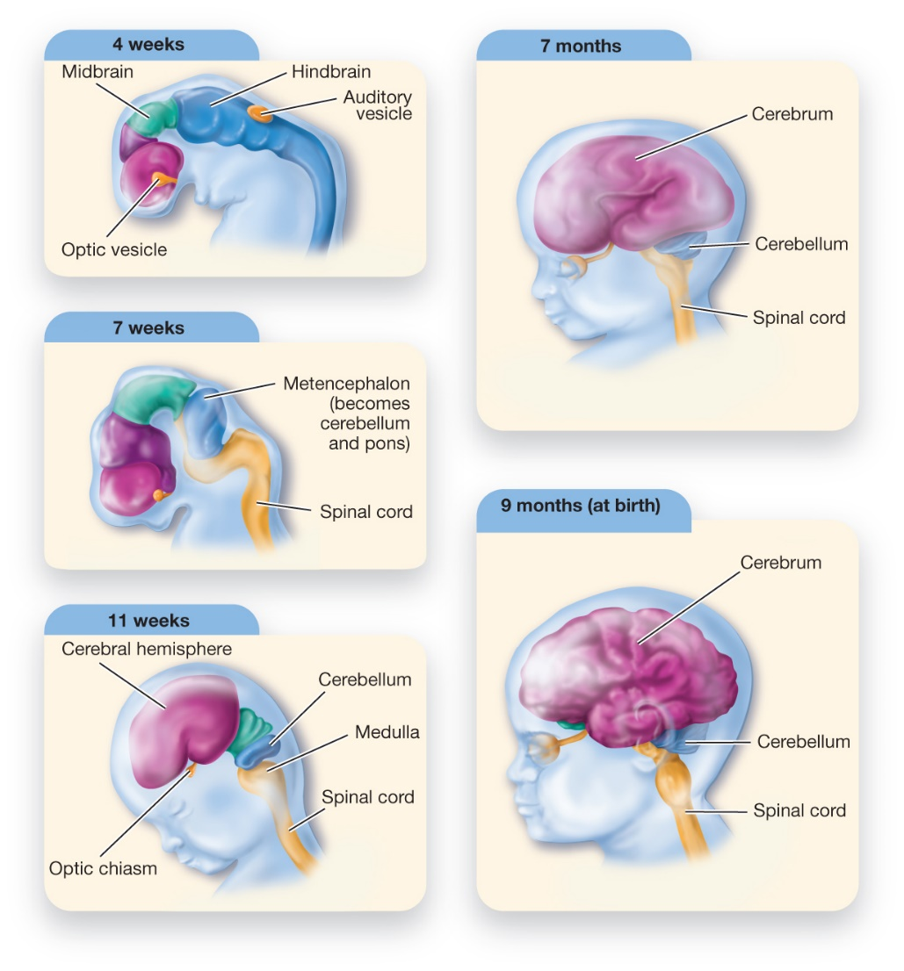
Fetal Brain Development
Figure 10.2 Fetal Brain Development
The origins of the major regions of the brain are already detectable at four weeks’ gestation. Their differentiation progresses rapidly, with the major forebrain, midbrain, and hindbrain regions becoming increasingly specialized.
Notes:
1) The beginning of the human brain can be seen during the embryonic stage, between the second and third weeks of gestation.
i) Brain development spans all the way to early adulthood.
2) Genetically programmed cells migrate to their appropriate sites and begin to differentiate into nerve cells.
i) Within two weeks of conception, a layer of specialized nerve cells begins to fold over onto itself, forming the neural tube, which eventually develops into the brain and spinal cord.
ii) The first sign of major divisions of the brain (the forebrain, midbrain, and hindbrain) are apparent at 4 weeks’ gestation (Figure 10.2).
iii) By 11 weeks’ gestation, the differentiations between the cerebral hemispheres, the cerebellum, and the brain stem are apparent.
iv) Myelination, a process of fatty tissue building up around developing nerve cells, occurs during the final month of pregnancy.
a) Myelin insulates nerve cells, enabling them to conduct messages more rapidly and efficiently (Module 3.2).
3) At birth, the newborn has around 100 billion neurons and a brain that is approximately 25% the size and weight of an adult brain.
4) Children’s brains have a very high amount of plasticity, so that whatever environments the child endures while growing up, her developing brain will be best able to learn to perceive and adapt to those environments. Our brains generally develop the patterns of biological organization that correspond to the world that we’ve experienced.
Long Description:
The parts of the brain are labelled on each scan. The periods when the scans are taken and the parts of the brain that are visible are as follows.
4 weeks: The head is not formed. A spinal cord-like structure is visible. The curved head of the spinal cord shows a purple ball-like part. Within it is a small yellow mass labelled “Optic vesicle.” The elongated parts below it in blue are “Midbrain” and “Hindbrain.” A small elliptical yellow-coloured part is labelled “Auditory vesicle.”
7 weeks: The head area of the fetus is now larger than at 4 weeks. The purple area is also larger and the yellow mass is shrunk. The blue part below the purple area is shown as two segments. The top of the second segment shows “Metencephalon (becomes cerebellum and pons).” The fetus shows a clear spinal cord. It starts from below the second blue segment and extends further down. The spinal cord is yellow in colour.
11 weeks: The head of the fetus is visible. Its eyes, cheeks, head, mouth, and forehead are formed. The purple mass is now formed into 2 folds of almost equal size. The blue segment below the purple area shows clear folds and is labelled “Cerebellum.” The scan shows the “Medulla” on which the “Cerebellum” rests. The spinal cord continues below the “Medulla.” The “Medulla” and the spinal cord are yellow in colour.
7 months: The fetus shows a large brain. A yellow coloured nerve connects the eye and the brain. The brain shows two large folds. The front fold is labelled “Cerebrum.” The scan shows a small blue part labelled “Cerebellum” below the “Cerebrum” and behind the “Medulla.” The spinal cord is also visible in the scan.
9 months (at birth): The scan shows a well-developed brain. The “Cerebrum” shows many folds. The eye and the brain are connected. The “Cerebellum” is labelled. The spinal cord runs through the back of the neck.

Slide 11
Nutrition, Teratogens, and Fetal Development
Teratogen (p. 366)
Alcohol
Cigarettes
Fetal Alcohol Syndrome (p. 366)
1.5 in 1000 worldwide
Likely higher
Stress
Notes:
1) Pregnant women typically need an almost 20% increase in energy intake during pregnancy, including foods high in protein and calcium.
i) Malnutrition as well as illness and drugs can result in mild to severe physical and psychological effects on the fetus.
Teratogen (p. 366) are substances, such as drugs or environmental toxins, that impair the process of development.
2) Alcohol and tobacco can be teratogens if consumed at the wrong times and in large amounts during pregnancy.
Fetal alcohol syndrome (p. 366) involves abnormalities in mental functioning, growth, and facial development in the offspring of women who use alcohol during pregnancy.
i) This condition occurs in roughly 1.5 per 1000 births worldwide (but is probably underreported).
ii) As little as one drink per day can cause detrimental effects on the fetus.
3) Smoking decreases blood oxygen and raises uterine concentrations of poisonous nicotine and carbon monoxide, increasing the risk of miscarriage or death during infancy.
i) Babies usually have a lower birth weight and are 30% more likely to be born premature.
ii) These babies are also at a great risk for having problems with some aspects of emotional development and impulse control.
4) Maternal stress activated genetic processes that can interfere with normal prenatal development.
i) Differences in geographic location and financial resources correlate to important factors such as better prenatal healthcare, nutrition, and stable social environments.
ii) Strong social sup- port and effective psychological coping skills are asso- ciated with positive fetal developmental.

Slide 12
Working the Scientific Literacy Model: The Long-Term Effects of Premature Birth (1 of 2)
What do we know about premature birth?
Preterm infants (p. 368)
25 weeks: 50% survival
30 weeks: 95% survival
How can science be used to help preterm infants?
NIDCAP
Notes:
1) What do we know about premature birth?
i) Humans are usually born at a gestation age of around 37 weeks (9 months).
Preterm infants (p. 368) are born earlier than 36 weeks.
ii) Children born at 25 weeks have a little better than 50% chance of surviving.
iii) However, because fetal development happens quickly, children born at 30 weeks have a 95% chance of survival.
iv) Survival is the first step, followed by possible short- and long-term negative effects on psychological and cognitive functioning.
2) How can science be used to help preterm infants?
i) One program, called the Newborn Individualized Developmental Care and Assessment Program (NIDCAP), is a behaviourally based intervention in which preterm infants are closely observed and given intensive care during early development.
ii) One important component is keeping the brain healthy and protected against potentially harmful experiences.
a) This includes minimizing lights, sound levels, and stress.
iii) One study randomly assigned 117 infants born at 29 weeks or fewer to receive either NIDCAP or standard care in a prenatal intensive care unit.
a) Within 9 months, the NIDCAP infants showed significantly improved motor skills, attention, and other behavioural measures.
b) NIDCAP infants also showed improved brain development, including more advanced development of neural pathways between major brain regions.
c) At 8 years, the children who had gotten NIDCAP care showed higher scores on some (not all) measures of thinking and problem solving, as well as better frontal lobe functioning.

Slide 13
Working the Scientific Literacy Model: The Long-Term Effects of Premature Birth (2 of 2)
Can we critically evaluate this research?
Small sample size
Why does the program work?
Why is this relevant?
9% of infants are born preterm
Simple interventions available:
Massage
Kangaroo care
Notes:
1) Can we critically evaluate this research?
i) The longitudinal study has a very small sample size (22 children).
a) Small samples also make it difficult to test the effects of interacting factors, such as whether the effectiveness of the program may depend on the child’s gender, on family socioeconomic status, ethnicity, or other factors.
ii) This study also does not identify why the program works—what specific mechanisms it affects that in turn improve development.
2) Why is this relevant?
i) An estimated 9% of infants are born preterm worldwide.
ii) Medical advances and interventions, such as NIDCAP, have greatly reduced the chances of long-term negative effects of preterm birth.
iii) In developing countries where medical care may be minimal or nonexistent, research has found some effective and simple interventions.
a) Massaging preterm infants 15 minutes a day can result in 50% greater daily weight gain, and it reduces stress.
b) Kangaroo care focuses on constant, ongoing physical contact between infants and their mothers, and it has shown to improve the physical and psychological health of preterm infants.

Slide 14
Myths in Mind: Vaccinations and Autism
1990 claim that MMR vaccine linked to autism
One dose given at year 1
Second does before starting school
Many parents refused
Lack of scientific support
Article retracted 2010
Notes:
1) In the late 1990s, a team of researchers claimed that the combined vaccination for measles, mumps, and rubella (MMR) was linked to the development of autism.
i) This vaccine is given to children around their first birthday and a second dose is given around the time they start school.
ii) Many parents heard this claim and refused to have the vaccine given to their children.
2) However, scientists were unable to replicate the original findings.
i) It was found that Andrew Wakefield, the doctor you published the study, had a financial interest in linking the disease with the vaccine.
a) His research was funded by lawyers who sued the makers of vaccines for damages.
ii) In 2010, the original paper was retracted by The Lancet, the medical journal that published it.

Slide 15
Sensory Development in Infancy
Sensory before birth
4 months gestation, brain receiving signals from eyes and ears
7-8 months gestation, fetus actively listening
Vision at birth
30 cm or less
20/20 by 12 months
Smell at birth
Cringe at foul odours
Discriminate mother’s breastmilk
Notes:
1) Compared to the offspring of other species, human infants are born almost completely helpless and require extended care as they develop their senses, strength, and coordination.
2) Sensory experiences and learning occur before birth.
i) By month four of gestation, the brain starts receiving signals from the eyes and ears.
ii) By seven to eight months of gestation, fetuses seem to be actively listening.
a) To test this, scientists had mothers read The Cat in the Hat to their fetus during the last six weeks of pregnancy.
b) At birth, their babies were given a pacifier that could be used to control a tape recording of their mother reading the story as well as stories that were not read before birth.
c) The babies sucked the pacifier much more to hear The Cat in the Hat.
3) Infants vision is limited at birth, but reaches the normal 20/20 visual capacity between 6 and 12 months of age.
i) Before this, infants see only 12-15 inches away (about the distance between the mother’s face while breastfeeding).
ii) Colour vision appears to develop around 2 months.
iii) By 8 months, infants can perceive basic shapes and objects as well as adults do.
4) Odours are strong memory cues for infants.
i) Like adults, newborns cringe when smelling something rotten or pungent, and they show a preference for the smell of sweets.
ii) Newborns can discriminate the scent of their mother’s breastmilk from the breastmilk of a stranger.
a) They even turn their head toward the scent of breastmilk, which helps initiate nursing.

Slide 16
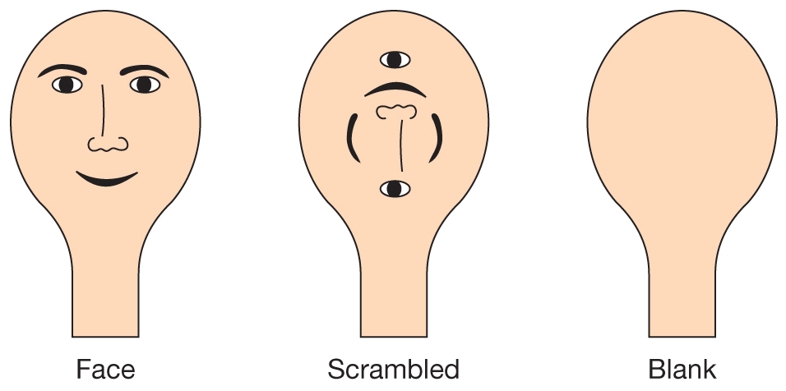
Visual Development in Infancy (1 of 2)
Figure 10.3 Experimental Stimuli for Studying Visual Habituation in Infants
Infants were shown three types of stimuli: a face-like stimulus, a scrambled face stimulus, and a neutral stimulus.
Notes:
1) The human face holds particular importance even for newborns. By a few days of age, they will imitate the facial expressions of others. Newborns prefer to look at stimuli that look like faces, compared to stimuli that have all the same features but are scrambled so that they don’t look like faces (Figure 10.3).
2) The proper development of the visual system is not guaranteed to happen; it’s not hardwired into our genes. Instead, the visual system develops in response to the infant experiencing a world of diverse visual input. It is the patterns in the world which develop the appropriate neural pathways in the visual cortex.
i) Interacting with the world is also necessary for the visual system to properly develop. This was illustrated by research involving the visual cliff. Researchers discovered that only babies who had some experience crawling showed fear of the deep end.
Long Description:
All 3 illustrations shows cardboard cut outs shaped like an electric bulb.
The first cut out labelled “Face” shows the illustration of a smiling human face with its eyebrows, eyes, nose, and mouth.
The second cut out labelled “Scrambled” shows the parts of the human face jumbled.
The third cut out labelled “Blank” shows a blank cardboard.

Slide 17
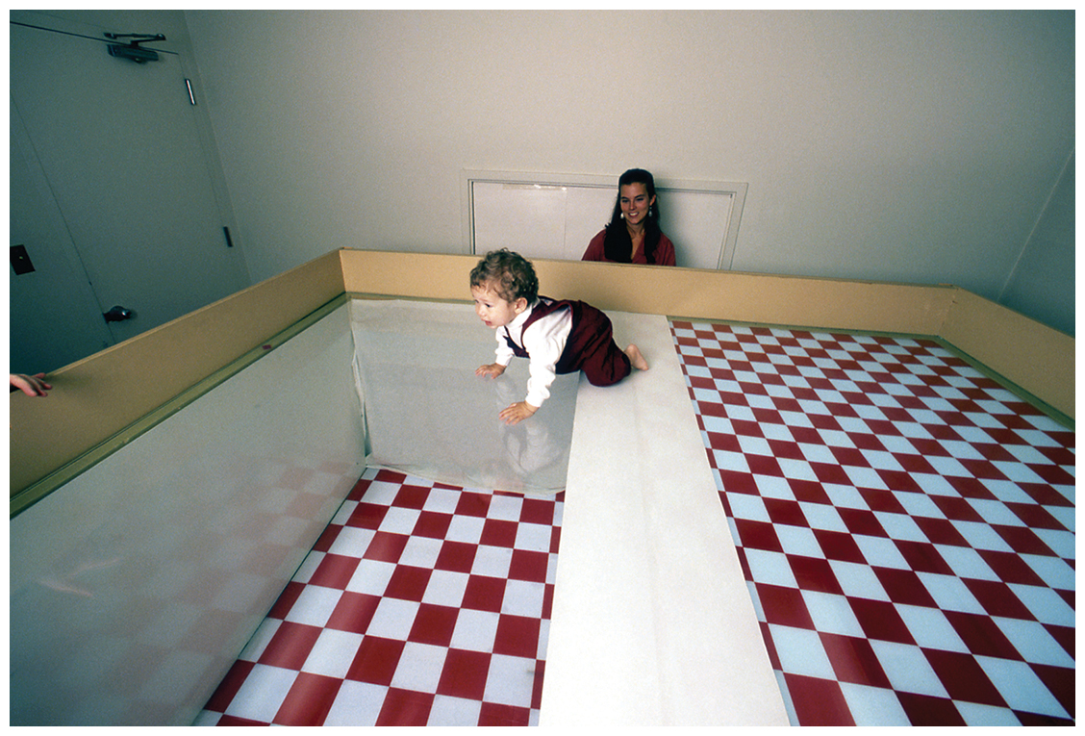
Visual Development in Infancy (2 of 2)
Figure 10.4 The Visual Cliff
Developmental psychologists use a visual cliff (not a real one!) to test for the development of depth perception in babies. The baby shown here has not yet acquired the perceptual experience of depth.
Mark Richard/PhotoEdit, Inc.
Notes:
1) The human face holds particular importance even for newborns. By a few days of age, they will imitate the facial expressions of others. Newborns prefer to look at stimuli that look like faces, compared to stimuli that have all the same features but are scrambled so that they don’t look like faces (Figure 10.3).
2) The proper development of the visual system is not guaranteed to happen; it’s not hardwired into our genes. Instead, the visual system develops in response to the infant experiencing a world of diverse visual input. It is the patterns in the world which develop the appropriate neural pathways in the visual cortex.
i) Interacting with the world is also necessary for the visual system to properly develop. This was illustrated by research involving the visual cliff. Researchers discovered that only babies who had some experience crawling showed fear of the deep end.
Long Description:
The table is divided into 3 lengths. One length of the table shows a tiled design followed by a white strip that forms the second length. The third length appears to be made of a transparent material. The area below the transparent material shows a tiled floor like that is the same as in the first length. The toddler is shown crossing the first length, the white strip, and entering the transparent length. A specialist seated across the table is seen watching the child.

Slide 18
Motor Development in the First Year (1 of 3)
Table 10.2 A Few Key Infant Reflexes
The Rooting Reflex
The rooting reflex is elicited by stimulation to the corners of the mouth, which causes infants to orient themselves toward the stimulation and make sucking motions. The rooting reflex helps the infant begin feeding immediately after birth.
The Moro Reflex
The Moro reflex, also known as the “startle” reflex, occurs when infants lose support of their head. Infants grimace and reach their arms outward and then inward in a hugging motion. This may be a protective reflex that allows the infant to hold on to the mother when support is suddenly lost.
The Grasping Reflex
The grasping reflex is elicited by stimulating the infant’s palm. The infant’s grasp is remarkably strong and facilitates safely holding onto their caregiver.
The Stepping Reflex
The stepping reflex, also known as the walking or dancing reflex, occurs when infants sense the onset of pressure on the sole of a foot. In fact, if you support the infant upright and gently lower the foot to a tabletop or surface, you will see the leg straighten. This reflex is the basis for learning to walk.
Notes:
1) By five moths’ gestation, the fetus begins to have control of voluntary motor movements.
i) In the last months of gestation and the first months of life, the muscles and nervous system develop enough to demonstrate basic reflexes.
Reflexes (p. 370) involuntary muscular reactions to specific types of stimulation.
ii) These reflexes provide infants with a basic set of responses for feeding and interacting with their caregivers (Table 10.2).

Slide 19
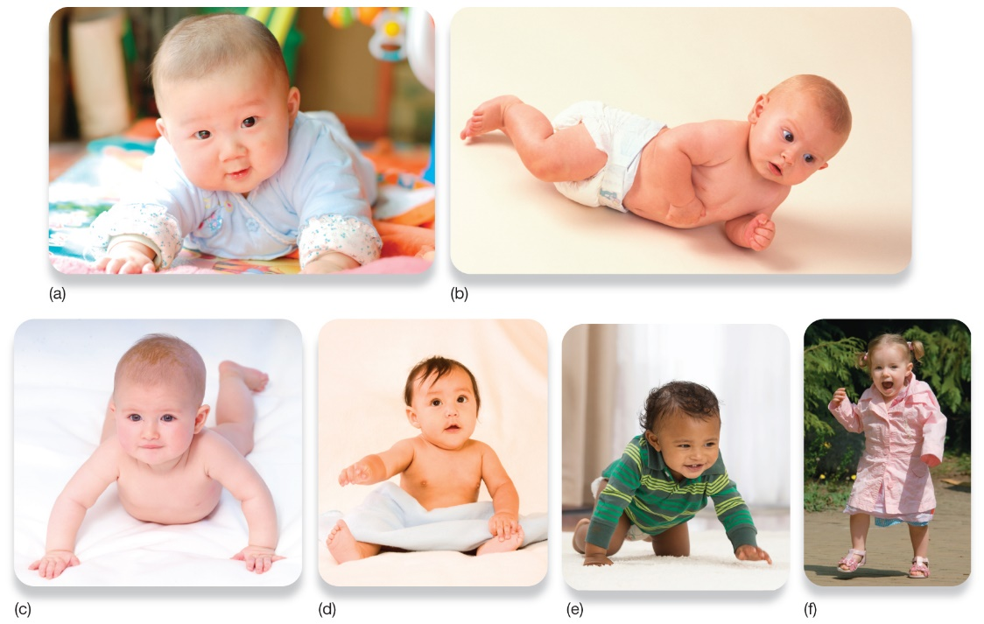
Motor Development in the First Year (2 of 3)
Figure 10.5 Motor Skills Develop in Stages
This series shows infants in different stages of development: (a) raising the head, (b) rolling over, (c) propping up, (d) sitting up, (e) crawling, and (f) walking.
Top, left: bendao/Shutterstock; top, right: Bubbles Photolibrary/Alamy Stock Photo; bottom, left: imageBROKER/Glow Images; bottom, centre left: OLJ Studio/Shutterstock; bottom, centre right: Corbis Bridge/Alamy Stock Photo; bottom, right: Eric Gevaert/Shutterstock
Notes:
1) In contrast to reflexes, the development of motor skills seems to rely more on practice and deliberate effort.
2) Infant abilities to move proceeds in stages—from crawling, to standing, to walking—over the course of the 12 to months of life (Figure 10.5).
i) However, some infants develop faster or slower than others.
ii) Cross-cultural differences in development may be due to parental expectations.
a) For example, one study asked mothers of different nationalities when they expected their newborns to perform different actions.
b) Compared to British and Indian mothers, Jamaican mothers gave earlier expected dates for sitting up and walking.
c) Infants born to Jamaican mothers walked at a significantly earlier age, likely because these infants were encouraged to practice these skills at an earlier age.
Long Description:
The positions and postures are as follows.
An infant raising its head while lying on its stomach
An infant trying to rollover its body
An infant lifting its body up while lying on its stomach, by pressing its palms on the floor
A seated infant
A crawling infant
A toddler walking on its two feet

Slide 20
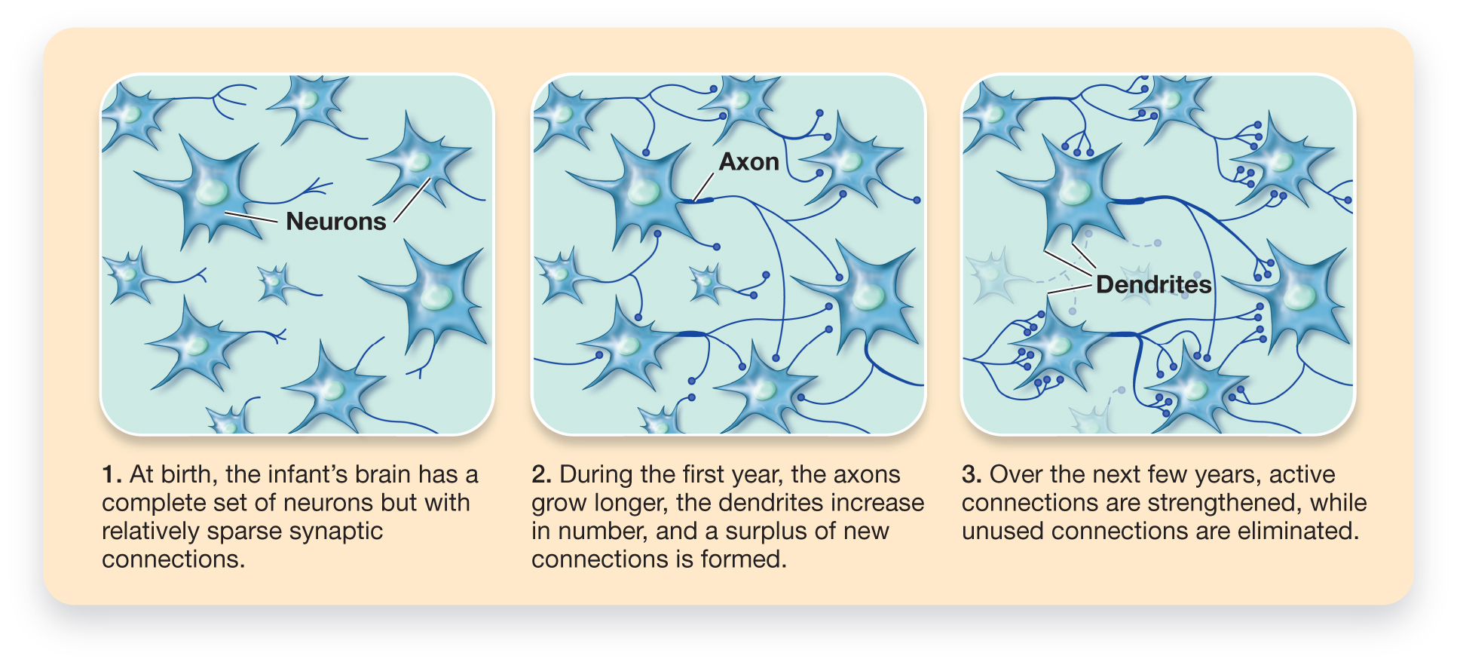
Motor Development in the First Year (3 of 3)
Figure 10.6 The Processes of Synaptic Pruning
Notes:
3) Changes in brain development correspond with the development of motor and cognitive abilities through late childhood.
i) Changes at the cellular level include myelination, which begins prenatally (Module 10.1), accelerates through infancy and childhood, and then continues gradually for several decades.
ii) In addition, two key events occur at the level of synapses: synaptogenesis and synaptic pruning.
Synaptogenesis (p. 372) describes the forming of new synaptic connections.
iii) Synaptogenesis occurs at blinding speed through infancy and childhood, and continues through the lifespan.
Synaptic pruning (p.372) refers to the loss of weak nerve cell connections.
iv.) Synaptic pruning accelerates during brain development through infancy and childhood (Figure 10.6), then tapers off until adolescence (see Module 10.3). Synaptogenesis and synaptic pruning serve to increase neural efficiency by strengthening needed connections between nerve cells and weeding out unnecessary ones.
Long Description:
The figure shows the pruning at 3 stages.
At birth: The figure shows many neurons. Each neuron is almost start-shaped with a circle inside it. Each neuron also shows a tail. A note reads “At birth, the infant’s brain has a complete set of neurons but not very many synaptic connections.”
During the first year: The figure shows many neurons. The tail-like structure of each neuron, labelled “Axon”, is shown connecting to other neurons. A note reads “During the first year, the axons grow longer, the dendrites increase in number, and a surplus of new connections is formed.”
Over the next few years: The figure shows many neurons. Some connections between neurons are shown in bold lines. The figure shows no connections between some neurons. A note reads “Over the next few years, active connections are strengthened, while unused connections disintegrate.”

Slide 21
10.2 Learning Objectives
Know the key terminology associated with infancy and childhood.
Understand the cognitive changes that occur during infancy and childhood.
Understand the importance of attachment and the different styles of attachment.
Apply the concept of scaffolding and the zone of proximal development to understand how to best promote learning.
Analyze how to effectively discipline children in order to promote moral behaviour.
Notes:
Know the key terminology associated with infancy and childhood.
See the bold, italicized terms below.
Understand the cognitive changes that occur during infancy and childhood.
According to Piaget’s theory of cognitive development, infants mature through childhood via orderly transitions across the sensorimotor, preoperational, concrete operational, and formal operational stages. This progression reflects a general transition from engaging in the world through purely concrete, sensory experiences, to an increasing ability to hold and manipulate abstract representations of the world in one's mind.
Understand the concept of attachment and the different styles of attachment.
In developmental psychology, attachment refers to the enduring social bond between child and caregiver. Based on the quality of this bond, which is dependent on appropriately responsive parenting, individuals develop an attachment style, which is their internalized feelings of security and self-worth. Children are either securely or insecurely attached, and insecure attachments can be further divided into disorganized, resistant, and avoidant styles.
Apply the concept of scaffolding and the zone of proximal development to understand how to best promote learning.
According to Vygotsky, cognitive development unfolds in a social context between caregivers/teachers and children. Adults who are attuned to the child's experience can help to scaffold children's learning, guiding them such that they focus on challenges that lie on the very edge of their capabilities. This keeps children engaged fully, in the zone of proximal development, maximizing their skill development and the intrinsic motivation that comes with a sense of emerging mastery
Analyze How to effectively discipline children in order to promote moral behaviour.
Internalizing prosocial motives comes from the child developing a secure attachment, and having empathy and inductive reasoning taught to them throughout their children. Children have an innate sense of morality, but this can be interfered with if their attachment needs are insufficiently met, and the attachment behavioural system takes precedence over the caregiving behavioural system. Therefore, responsive parenting that helps the child feel secure, lays the foundation for the child to become less self-focused. As the child cognitively develops and can more explicitly take others' perspective, inductive reasoning that emphasizes perspective taking and having empathy for how the child's behaviour affects others, builds the habit of "doing good" because the child genuinely cares, not because they want approval or to avoid punishment

Slide 22
The Importance of Sensitive Periods
Sensitive period (p. 375)
Language fluency
Perception
Balance
Recognition of parents
Identifying with a particular culture
Notes:
1) During infancy and childhood, exposure to specific types of environmental stimulation is critical to healthy development.
i) For example, to become fluent in their native language, infants need to be exposed to speech during their first few years of life.
Sensitive period (p. 375) is a window of time during which exposure to a specific type of environmental stimulation is needed for normal development of a specific ability.
ii) Sensitive periods exist for humans and other species for abilities such as depth perception, balance, and recognition of parents, and, for humans at least, identifying with a particular culture.

Slide 23
Cognitive Changes: Piaget’s Cognitive Development Theory
Table 10.3 Piaget’s Stages of Cognitive Development
Stage | Description
Sensorimotor (0–2 years) | Cognitive experience is based on direct sensory experience with the world, as well as motor movements that allow infants to interact with the world. Object permanence is the significant developmental milestone of this stage.
Preoperational (2–7 years) | Thinking moves beyond the immediate appearance of objects. The child understands physical conservation and that symbols, language, and drawings can be used to represent ideas.
Concrete operational (7–11 years) | The ability to perform mental transformations on objects that are physically present emerges. Thinking becomes logical and organized.
Formal operational (11 years–adulthood) | The capacity for abstract and hypothetical thinking develops. Scientific reasoning becomes possible.
Notes:
1) Jean Piaget (1896-1980) is often credited with initiating the modern science of cognitive development.
Cognitive development (p. 375) the study of changing abilities and processes of memory, thought, and reasoning processes that occur throughout the lifespan.
2) According to Piaget, knowledge accumulates and is modified by two processes—assimilation and accommodation.
Assimilation (p. 375) is the process of fitting new information into the belief system one already possesses.
i) For example, a child who is familiar with the family’s pet Chihuahua might develop a concept that all dogs are furry creatures that stand less than a foot tall, until her concept is modified.
Accommodation (p. 375) is a creative process whereby people modify their belief structures based on experience.
ii)For example, the child might refer to a Great Dane as a “horse,” but will eventually correctly accommodate Great Dane into her concept of what a dog is.
3) Piaget’s research suggested that cognition develops in four distinct stages from birth through early adolescence: the sensorimotor stage, the preoperational stage, the concrete operational stage, and the formal operational stage.
i) Developmental milestones are an important aspect of this theory.
a) As infants and children progress from one stage to the next, they obtain mastery of important concepts or skills (Table 10.3).

Slide 24
The Sensorimotor Stage: Objects and the Physical World
Sensorimotor stage (p. 375)
Birth to 2 years
Object permanence (p. 376)
Hidden toy test
Notes:
1) Infants’ thinking and exploration of the world are based on immediate sensory (e.g., seeing, touching) and motor (e.g., grasping, mouthing) experiences.
i) This is in contrast to adults who can imagine people, places, and objects that are not present.
Sensorimotor stage (p. 375): spans from birth to two years, during which infants’ thinking about and exploration of the world are based on immediate sensory
(e.g., seeing, feeling) and motor (e.g., grabbing, mouthing) experiences.
ii) The major milestone of this stage is object permanence.
Object permanence (p. 376) the ability to understand that objects exist even when they cannot be directly perceived.
a) To test for object permanence, Piaget would allow a child to reach for a toy and then place a barrier between the infant and the toy.
b) If the infant stopped reaching for the toy (looking for something else to do), this marked a lack of object permanence.

Slide 25
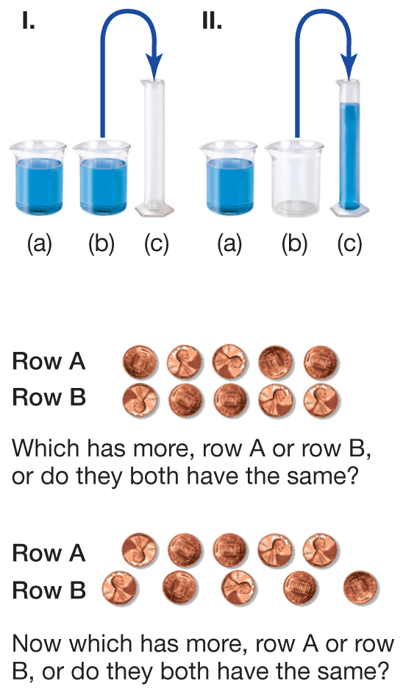
The Preoperational Stage: Quantity and Numbers (1 of 2)
Figure 10.7 Testing Conservation
A child views two equal amounts of fluid, one of which is then poured into a taller, narrower container. Children who do not yet understand conservation believe that there is more fluid in the tall container compared to the shorter one. A similar version of this task can be tested using equal arrays of separate objects. When the two rows of coins are the same length, the child agrees that they have the same number. But when one row is spread out, it becomes bigger, and so the preoperational child will identify that row as having more.
Source: Lilienfeld, S. O., Lynn, S. J., Namy, L. L., & Woolf, N. J. (2011). Psychology: From Inquiry to Understanding, 2nd ed., ©2011. Reprinted and electronically reproduced by permission of Pearson Education, Inc., New York, NY.
Notes:
1) Once children have mastered sensorimotor tasks, they have progressed to the preoperational stage of development.
Preoperational stage (p. 376) (spans ages two through seven years) is devoted to language development, the use of symbols, pretend play, and mastering the concept of conservation.
i) During this stage, children can look at and think about objects, although they have not quite attained abstract thinking abilities.
a) They may count objects and use numbers in their language, but they are still limited in their use of mental operations.
Conservation (p. 376) is the knowledge that the quantity or amount of an object is not the same as the physical arrangement and appearance of that object.
2) To test for conservation, a researcher might present a child with two identical rows of seven pennies (Figure 10.7).
i) The researcher then spreads one row out and asks the child which row has more pennies.
a) The child in the preoperational stage would answer based on immediate perception, instead of using more sophisticated mental operations.
3) Although Piaget emphasized developmental stages, he also recognized that mastery of cognitive tasks didn’t occur overnight.
i) Factors like motivation influence whether children appear to understand tasks, such as in conservation.
a) For example, when children are presented with M&Ms (vs. pennies) and fewer M&Ms are present in the row that is spread out, children will pick the row with more candy (especially if they get to eat it).
ii) Children late in the preoperational stage may verbally say the wrong answer, but begin using their hands to gesture toward the correct row.
4) Children seem to have a “number sense” before they understand numbers.
i) Infants appear to understand what it means to have less or more of something.
Long Description:
First illustration
The first set shows two small equal-sized containers having the same quantity of fluid. The set also shows an empty tall container. An arrow indicates that the fluid from one of the smaller containers is poured into the tall container.
The second set shows two small equal-sized containers. One container has fluid and the second container is empty. The set also shows a tall container filled with fluid. An arrow indicates that the fluid from the container that is empty was poured into the tall container.
Second illustration
The illustration shows two rows, Row “A” and Row “B”, of 5 coins each. The coins are placed one below the other. A question reads “Which has more, row “A” or row “B,” or do they both have the same?”
Third illustration
The illustration shows two rows, Row “A” and Row “B”, of 5 coins each. The coins are placed such that the coins in row “B” are placed far away from each other than in row “A.” A question reads “Which has more, row “A” or row “B,” or do they both have the same?”

Slide 26
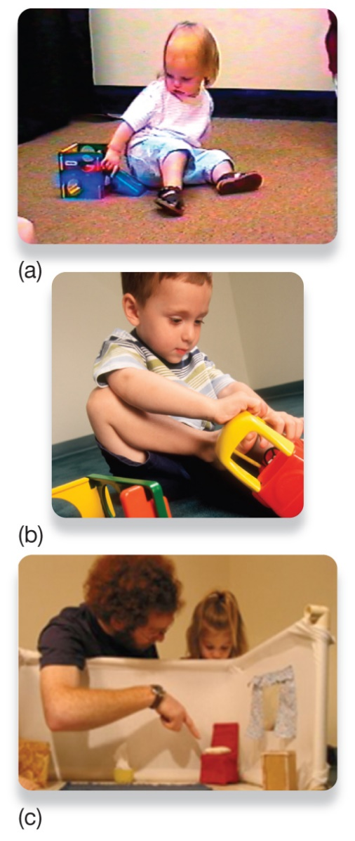
The Preoperational Stage: Quantity and Numbers (2 of 2)
Figure 10.8 Scale Errors and Testing for Scale Model Comprehension
The children in photos (a) and (b) are making scale errors. One child is attempting to slide down a toy slide and another is attempting to enter a toy car. Three-year-olds understand that a scale model represents an actual room (c). The adult pictured is using a scale model to indicate the location of a hidden object in an actual room of this type. At around three years of age, children understand that the scale model symbolizes an actual room and will go directly to the hidden object after viewing the scale model.
Courtesy of Judy DeLoache
Notes:
5) Children are still developing their ability to think abstractly, but are beginning to understand some basics (Figure 10.8).
i) Before the age 2 to 2 1/2 years, children commit scale errors.
a) They might try to slide down a doll-sized slide or get into a miniature toy car as if they are the real thing.
ii) Around age 3, children begin to develop a sense for symbolic relationships.
a) For example, 3-year-olds understand that a scale model of a room can symbolize an actual room.
b) Children can watch an experimenter play a toy in the scale model and quickly locate the toy in the corresponding location of the actual room.
Long Description:
The first photo shows a child attempting to slide down a tiny toy slide.
The second photo shows a child trying to enter into a very small toy car.
The third photo shows an adult pointing to an object placed behind a white partition and explaining to a child.

Slide 27
The Concrete Operational Stage: Using Logical Thought
Concrete operational stage (p. 377)
7 to 11 years
Transitivity
Notes:
1) Conservation is one of the milestones marking the transition into the concrete operational stage
Concrete operational stage (p. 377) (spanning 7 to 11 years) is when children develop skills in logical thinking and manipulating numbers.
i) Children in this stage can classify objects according to properties such as size, value, shape, or some other physical characteristic.
ii) Thinking becomes increasingly logical and organized.
a) For example, a child in the stage recognizes that if X is more than Y, and Y is more than Z, then X is more than Z (a property called transitivity).

Slide 28
The Formal Operational Stage: Abstract and Hypothetical Thought
Formal operational stage (p. 378)
11 years to adulthood
Scientific thinking
Notes:
1) The ability to think logically about physical objects transitions into more abstract realms in the fourth and final stage.
Formal operational stage (p. 378) (spanning 11 years of age into adulthood) involves the development of advanced cognitive processes such as abstract reasoning and hypothetical thinking.
i) Scientific thinking, such as gathering evidence and systematically testing possibilities, occurs.
ii) Thinking can exist entirely in hypothetical realms.

Slide 29
Working the Scientific Literacy Model: Evaluating Piaget (1 of 3)
What do we know about cognitive abilities in infants?
Core knowledge hypothesis (p. 378)
Habituation (p. 378)
Dishabituation (p. 378)
Notes:
2) How can science help explain infant cognitive abilities?
i) The habituation-dishabituation response has been studied in infants as young as two days old (Figure 10.8).
a) The infants were shown either 4 or 12 identical shapes (e.g., yellow triangles) and they heard either 4 or 12 tones (e.g., tu-tu-tu-tu).
b) The shape or tone themselves didn’t matter; the infants were attentive to matches (i.e., 4 shapes with 4 tones).
c) The researchers believe this reflects infants’ rudimentary appreciation for abstract numbers.

Slide 30
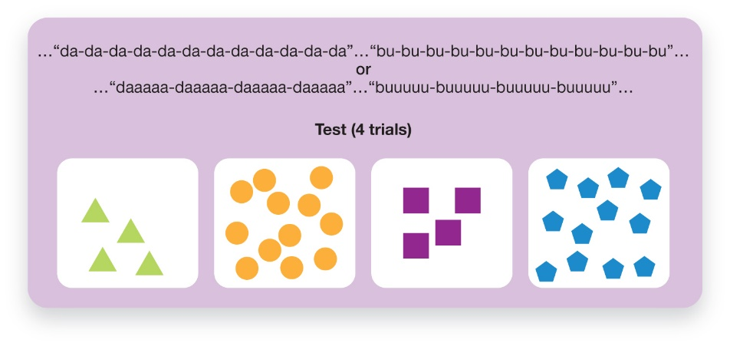
Working the Scientific Literacy Model: Evaluating Piaget (2 of 3)
How can science help explain infant cognitive abilities?
Figure 10.9 Testing Infants’ Understanding of Quantity
In this study, infants listened to tones that were repeated either 4 or 12 times while they looked at objects that had either 4 or 12 components. Infants spent more time looking at visual arrays when the number of items they saw matched the number of tones they heard.
Notes:
2) How can science help explain infant cognitive abilities?
i) The habituation-dishabituation response has been studied in infants as young as two days old (Figure 10.9).
a) The infants were shown either 4 or 12 identical shapes (e.g., yellow triangles) and they heard either 4 or 12 tones (e.g., tu-tu-tu-tu).
b) The shape or tone themselves didn’t matter; the infants were attentive to matches (i.e., 4 shapes with 4 tones).
c) The researchers believe this reflects infants’ rudimentary appreciation for abstract numbers.
Long Description:
The panels and the shapes within them are as follows.
Panel 1: Four green-coloured triangles
Panel 2: Twelve orange-coloured circles
Panel 3: Four purple-coloured squares
Panel 4: Twelve blue-coloured pentagons
A note reads “…“da-da-da-da-da-da-da-da-da-da-da-da”…“bu-bu-bu-bu-bu-bu-bu-bu-bu-bu-bu-bu”… or …“daaaaa-daaaaa-daaaaa-daaaaa”…“buuuuu-buuuuu-buuuuu-buuuuu”…”

Slide 31
Working the Scientific Literacy Model: Evaluating Piaget (3 of 3)
Can we critically evaluate this research?
Not all agree “looking time” is the best measure
Only 16 infants
Why is this relevant?
Need to stimulate infant
Notes:
1) Can we critically evaluate this research?
i) Many studies of early cognitive development use the “looking time” procedure, although not all psychologists agree that it is an ideal way of determining what infants understand.
a) It is impossible to know what infants are thinking. They might look longer at certain events simply because they are more interesting.
ii) We also can’t generalize findings from 16 infants that were two days old.
a) Another 45 infants were too fussy or sleepy to successfully finish the task.
2) Why is this relevant?
i) Habituation seems a lot like boredom in infants.
a) Playing with a variety of toys, hearing various stories and songs, and interacting with different people will encourage the infants’ curiosity and stimulate intellectual development.

Slide 32
Complementary Approaches to Piaget
Vygotsky
Zone of proximal development (p. 380)
Scaffolding (p. 380)
Cultural differences
Notes:
1) Piaget’s theories have had a lasting impact on modern developmental psychology; however, the details of his theories have generated some controversy.
i) Piaget generally underestimated the abilities of infants and their rates of development.
ii) He overlooked sociocultural and biological elements of cognitive growth.
2) The sociocultural context of development involves the dynamics between children and their parents, teachers, and peers.
i) This is part of Lev Vygotsky’s zone of proximal development.
Zone of proximal development (p. 380) development is ideal when a child attempts skills and activities that are just beyond what he or she can do alone, but the child has guidance from adults who are attentive to his or her progress.
ii) This is an interaction approach to teaching and learning that facilitates knowledge building and understanding in children.
Scaffolding (p. 405) is the approach to teaching in which the teacher matches guidance to the learner’s needs.
3) Cross-cultural research on parent-infant interactions shows that scaffolding is exercised in different ways.
i) For example, one study looked at how parents from Turkey, Guatemala, and the United States interacted with their 12-24 month-old children.
a) The children were given a toy that required them to pull a string to make it move.
b) All parents used scaffolding to teach their child to pull the string, but the Guatemalan parent-child pairs were more communicative with each other, both verbally and through gesture.

Slide 33
Social Development and Attachment (1 of 2)
Attachment (p. 381)
Harry Harlow’s monkey experiments
Strange situation test (p.382)
Notes:
1) Intense social bonding between humans starts with the dynamic between infant and caregiver.
Attachment (p. 381) is an enduring emotional bond formed between individuals, initially between infants and caregivers.
i) Attachment is a motivation to seek out others for close physical and psychological comfort, especially during stressful situations.
2) From an evolutionary perspective, safety and survival underlie the motivation for attachment.
i) It was thought that the infants would form attachments to whoever satisfies their hunger or thirst (basic survival needs).
ii) However, in the 1950s Harry Harlow’s experiments with monkeys suggested that physical contact, rather than food, formed the basis for mother-infant bonding.
a) He built two monkey-looking models from mesh wire. One had a terrycloth wrapped around it, but no food. The other had food, but was only made of wire.
b) The infant monkey spent most of its time clinging to the softer model.
iii) Additional studies by Harlow deprived primates of social contact during infancy.
a) These primates showed abnormal social and sexual behaviours in adulthood.
b) However, when given regular social contact, their behaviour returned to relatively normal levels.
3.) To study attachment in human infants, researchers often use the strange situation.
Strange Situation test (p. 382) is a way of measuring infant attachment by observing how infants behave when exposed to different experiences that involve anxiety and comfort.
i) Around 8 months of age, infants become distressed when they encounter someone unfamiliar (stranger anxiety).
a) This may result in crying and actively seeking out caregivers.
ii) Experiments using the strange situation, have a caregiver bring her child into a room with toys on the floor and a stranger nearby.
a) The mother leaves the room for a few moments and returns; meanwhile, the experimenter monitors the infant.
b) Attachment styles are categorized by the reactions the infants exhibit when the mother leaves and returns (Figure 10.11).

Slide 34
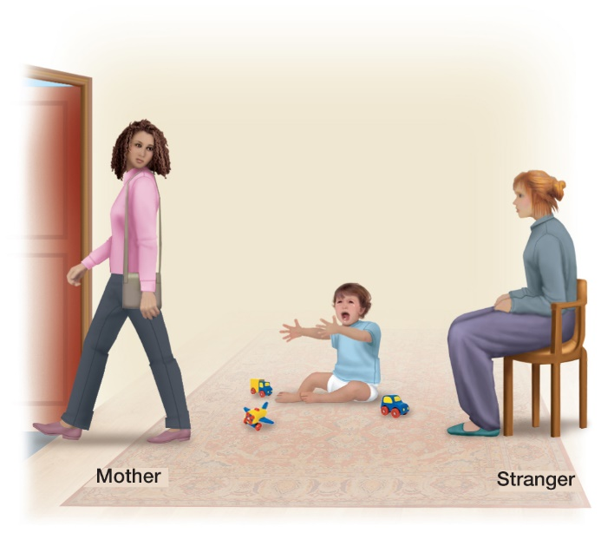
Social Development and Attachment (2 of 2)
Figure 10.11 The Strange Situation
Studies of attachment by Mary Ainsworth involved a mother leaving her infant with a stranger. Ainsworth believed that the infants’ attachment styles could be categorized according to their behavioural responses to the mother leaving and returning.
Source: Lilienfeld, S. O., Lynn, S. J., Namy, L. L., & Woolf, N. J. (2011). Psychology: From Inquiry to Understanding, 2nd ed., © 2011. Reprinted and electronically reproduced by permission of Pearson Education, Inc., New York, NY.
Notes:
1) Intense social bonding between humans starts with the dynamic between infant and caregiver.
Attachment (p. 381) is an enduring emotional bond formed between individuals, initially between infants and caregivers.
i) Attachment is a motivation to seek out others for close physical and psychological comfort, especially during stressful situations.
2) From an evolutionary perspective, safety and survival underlie the motivation for attachment.
i) It was thought that the infants would form attachments to whoever satisfies their hunger or thirst (basic survival needs).
ii) However, in the 1950s Harry Harlow’s experiments with monkeys suggested that physical contact, rather than food, formed the basis for mother-infant bonding.
a) He built two monkey-looking models from mesh wire. One had a terrycloth wrapped around it, but no food. The other had food, but was only made of wire.
b) The infant monkey spent most of its time clinging to the softer model.
iii) Additional studies by Harlow deprived primates of social contact during infancy.
a) These primates showed abnormal social and sexual behaviours in adulthood.
b) However, when given regular social contact, their behaviour returned to relatively normal levels.
3.) To study attachment in human infants, researchers often use the strange situation.
Strange Situation test (p. 382) is a way of measuring infant attachment by observing how infants behave when exposed to different experiences that involve anxiety and comfort.
i) Around 8 months of age, infants become distressed when they encounter someone unfamiliar (stranger anxiety).
a) This may result in crying and actively seeking out caregivers.
ii) Experiments using the strange situation, have a caregiver bring her child into a room with toys on the floor and a stranger nearby.
a) The mother leaves the room for a few moments and returns; meanwhile, the experimenter monitors the infant.
b) Attachment styles are categorized by the reactions the infants exhibit when the mother leaves and returns (Figure 10.11).

Slide 35
Types of Attachment
Secure attachment
Insecure attachment
Disorganized
Anxious/Ambivalent
Avoidant
Notes:
1) Using this procedure, researchers have identified the following categories of attachment:
i) Secure attachment: In the strange situation, the child plays comfortably while the mother is in the room. The child may or may not cry when the mother leaves, and seeks contact upon her return.
ii) Insecure attachment: there are three subtypes:
a) Disorganized: The child does not have a consistent pattern of behaviour when the mother leaves or returns. The child might freeze for a moment, unsure of what to do next.
b) Anxious/Ambivalent: The child is upset with the mother leaves, but is angry when she returns.
c) Avoidant: The child is not upset when the mother leaves, and does not seek contact when she returns.
2) The type of attachments infants form result from the emotional and communicative responses between parent and infant.
i) Those that are closely coordinated form secure attachment styles.
ii) Insecure attachments are more likely if parents respond inconsistently and slowly to their infants.
3) The anxiety children experience when their primary caregiver is absent declines around 13 months of age.
i) However, attachments continue to form across the life span and in other contexts, such as romantic relationships.
a) Patterns of attachment in romantic relationships reflect back on styles of attachment formed during infancy.
b) A 20-year longitudinal study found that securely attached infants were better able to handle conflict with their romantic partners.

Slide 36
Parenting and Attachment
Attachment behavioural system (p. 383)
Caregiving behavioural system (p. 383)
Conditional approaches
Introjection (p. 383)
Inductive discipline (p. 383)
Notes:
1) Parenting involves a tension between two psychobiological systems:
The attachment behavioural system (p. 383) is focused on meeting our own needs for security.
The caregiving behavioural system (p. 383) is focused on meeting the needs of others.
i) The attachment system is primary, and if it is activated, it tends to shut down the caregiving system. In everyday experience, if a person feels insecure, it will be hard for them to take others’ needs into consideration. However, if attachment needs are fulfilled, then the caregiving system responds to others’ distress, motivating the person to care for others.
a) Raising kind, moral children is about helping them feel loved and secure, not just teaching them right from wrong.
2) Faced with the constant challenge of managing their kids’ behaviour, parents commonly turn to the principles of operant conditioning, using rewards and punishments as necessary. However, children are not merely stimulus-response machines, and this pervasive use of conditional approaches, sows the seeds for many problems that crop up over time. One of the almost invisible but highly damaging problems is that even though rewards do successfully produce the desired behaviours in children, these behaviours don’t tend to persist; the child won’t keep engaging in the behaviour unless they continue to receive rewards.
3) Children who experience their parents' regard for them as conditional report more negativity and resentment toward their parents. They also feel greater internal pressure to do well.
Introjection (p. 383) refers to the internalization of the conditional regard of significant others.
4) Research clearly shows that moral development is associated with more frequent use of inductive discipline.
Inductive discipline (p. 383) involves explaining the consequences of a child’s actions on other people, activating empathy for others’ feelings .

Slide 37
Self-Awareness (1 of 3)
Self-awareness (p. 384)
Reflection in mirror
Egocentric (p. 384)
Notes:
1) Between 18 and 24 months of age, toddlers and young children show evidence of self-awareness.
Self-awareness (p. 384) is the ability to recognize one’s individuality.
i) Self-awareness is tested by observing infants’ reactions to their reflection in a mirror or on a video.
a) Children start by recognizing themselves in the mirror or video and progress to having the ability to reflect on one’s own feelings, decisions, and appearance.
ii) By age 5, children become self-reflective, show concern for others, and are intensely interested in the causes of other people’s behaviour.
2) Until they develop awareness of others, young children are often described as “egocentric.”
Egocentric (p. 384) means that they only consider their own perspective.
i) It’s not that they are selfish or inconsiderate, they just can only perceive the world from their perspective.
a) For example, a two-year-old may hide by covering her eyes because, to her, she is hiding.

Slide 38
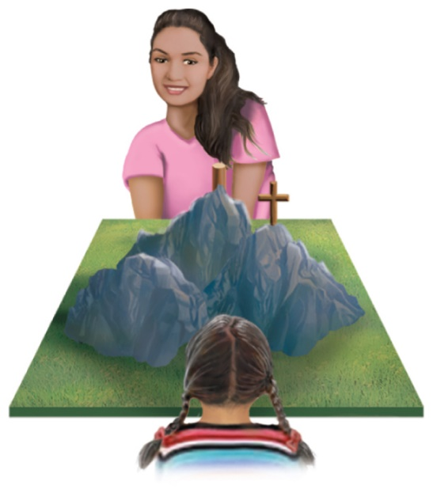
Self-Awareness (2 of 3)
Figure 10.12 Piaget’s Test for Egocentric Perspective in Children
Piaget used the three-mountain task to test whether children can take someone else’s perspective. The child would view the object from one perspective while another person viewed it from a different point of view. According to Piaget, children are no longer exclusively egocentric if they understand that the other person sees the object differently.
Notes:
2) Con’t
ii) Piaget tested for egocentrism by sitting a child in front of an object, and then presenting pictures of that object from four angles (Figure 10.12).
a) While sitting opposite the child, Piaget would ask him or her to identify which image represented the object from Piaget’s perspective.
b) Many children select the image corresponding to their own perspective.
c) Piaget believed children were egocentric through the preoperational stage (ending around age 7).

Slide 39
Self-Awareness (3 of 3)
Theory of mind (p. 384)
False-belief task
Notes:
3) However, modern research indicates that children take the perspective of others long before the preoperational phase is complete.
Theory of mind (p. 384) is the ability to recognize the thoughts, beliefs, and expectations of others, and to understand that these can be different from one’s own.
i) Researchers test for this using the false-belief task.
a) They give a child (Andrea) a box of chocolate only to find it’s filled with pencils (tricked her).
b) Then another child (Joseph) comes into the room and the researcher gives him the same box of chocolates.
c) The researcher asks Andrea what she thinks Joseph will find in the box.
d) If she says pencils, she does not understand that Joseph is being misled and thinks Joseph knows the same thing she does.
e.) If she says chocolates, she understands it’s a trick, therefore she can take the mental perspective of another.
ii) Children usually show theory of mind around the ages 4-5, but it doesn’t occur overnight.
a) Older children may still have difficulty with perspective taking.
b) Such findings suggest that children move away from egocentric thought at an earlier age than once believed.

Slide 40
Psychosocial Development Across the Lifespan (1 of 2)
Infancy
Sense of security
Toddlerhood
Exploring autonomy
Early Childhood
Pushing boundaries and experimenting
Childhood
Active engagement
Notes:
1) A pioneer in the study of development across the lifespan, Erik Erikson, proposed a theory of development consisting of overlapping stages that extend
from infancy to old age. Erikson’s theory centered around the notion that at different ages, people face particular developmental crises, or challenges, based on emotional needs that are most relevant to them at that stage of life.
2) The first stage, trust versus mistrust (infancy), focuses on developing a basic sense of security, of feeling comfortable (or at least not terrified) in a strange and often indifferent world
3) In the second stage of autonomy versus shame (toddlerhood), the toddler discovers that she is a separate creature from others and from the environment; thus,
exploring her feelings of autonomy—exercising her will as an individual in the world—becomes very important.
4) The third stage is one of initiative versus guilt (early childhood); the growing child learns to take responsibility for herself while feeling like she has the ability to influence parts of her physical and social world.
5) In the fourth stage of industry versus inferiority (childhood), the child is focused on the tasks of life, particularly school and the various skill development activities
that take place for that big chunk of childhood.

Slide 41
10.3 Learning Objectives
Know the key terminology concerning adolescent development.
Understand the process of identity formation during adolescence.
Understand the importance of relationships in adolescence.
Understand the functions of moral emotions
Apply your understanding of the categories of moral reasoning.
Analyze the relationship between brain development and adolescent judgment and risk taking.
Notes:
Know the key terminology concerning adolescent development.
See bold, italicized terms below.
Understand the different ways in which identity develops.
A major challenge of adolescence is the formation of a personal identity, which involves exploration different values and behaviours, and seeking inclusion in different social groups. The eventual outcome, if navigated successfully, is a relatively stable and personally satisfying sense of self.
Understand the central importance of relationships in adolescence.
Teenagers undergo a general shift in their social attachments, as family becomes less central and friends and intimate relationships take on increased significance. The failure to establish a sense of belonging is an important precursor to dysfunctional behaviours and violence.
Understand the functions of moral emotions.
Contrary to theories of moral reasoning, recent research on moral emotions, such as disgust, suggests that these feelings are what leads to moral behaviour, and reasoning generally follows as a way of justifying the behaviour to oneself.
Apply your understanding of the categories of moral reasoning.
Students should be able to identify categories of moral reasoning (preconventional, conventional, or postconventional) in responses to moral dilemmas.
Analyze the relationship between brain development and adolescent judgment and risk taking.
Problems with judgment may involve a region of the brain called the prefrontal cortex, which is involved in planning, reasoning, and emotion and impulse control. This region of the brain continues to change, via myelination and synaptic pruning, during adolescence. The underdeveloped state of this structure may account for the problems with decision making and impulse control observed during adolescence. Nevertheless, this factor by itself does not explain such problems, as adolescents who may avoid risk and make prudent decisions also have cortical areas that are not yet fully mature.

Slide 42
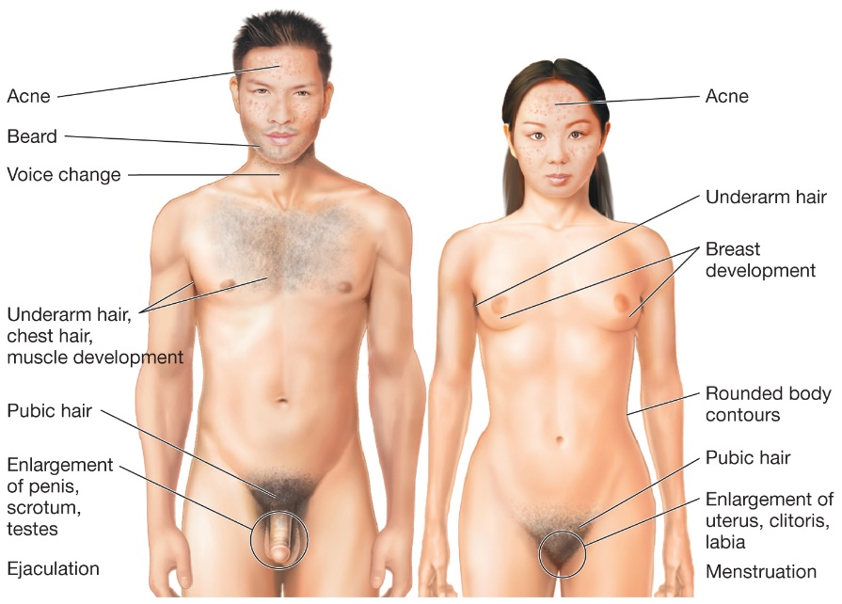
Physical Changes in Adolescence
Figure 10.14 Physical Changes That Accompany Puberty in Male and Female Adolescents
Hormonal changes accelerate the development of physical traits in males and females. Changes involve maturation of the reproductive system (primary sex traits) as well as secondary sex traits such as enlargement of breasts in women and increased muscle mass in males.
Notes:
1) Puberty marks the physical transition from childhood to adolescence, culminating in reproductive maturity.
i) Puberty begins at approximately age 11 in girls and age 13 in boys, although there is wide variation.
2) The changes that occur during puberty are primarily caused by hormonal activity.
i) Physical growth is stimulated by the pituitary gland.
ii) The nervous and reproductive systems interact to cause further physical changes to reproductive anatomy.
iii) They hypothalamus begins stimulating the release of hormones such as testosterone and estrogen, both of which contribute to the development of sex characteristics (Figure 10.14).
Primary sex traits (p. 390) are changes in the body that are part of reproduction (e.g., enlargement of the genitals, ability to
ejaculate, the onset of menstruation).
Secondary sex traits (p. 390) are changes in the body that are not part of reproduction (e.g. the growth of pubic hair, increased breast size in females,
and increased muscle mass in males)
3) Sexual maturity is also marked by menarche is females and spermarche in males.
Menarche (p. 390) the onset of menstruation.
i) Menarche usually occurs around age 12, but the timing is influenced by physiological and environmental factors (e.g., nutrition, genetics, physical activity levels, and illness).
a) The absence of a father or presence of a stepfather during development is associated with early onset of menarche.
Spermarche (p. 391) first ejaculation of sperm.
ii) Spermarche usually happens around 14 years of age as a nocturnal emission (wet dream).
4) Girls who reach puberty early tend to have more emotional difficulty with the experience than do boys.
i) Acquiring masculine traits at an early age is regarded positively by the individual and his peers.
ii) Early developers have a greater risk of drug and alcohol abuse and unwanted pregnancies.
Long Description:
The figure shows the following notes pointing to the various parts of the male and female bodies.
Male
Forehead: Acne
Cheeks: Beard
Throat: Voice change
Arm pit and chest: Underarm hair, chest hair, muscle development
Pubic area: Pubic hair
Penis: Enlargement of penis, scrotum, testes; Ejaculation
Female
Forehead: Acne
Armpit: Underarm hair
Chest: Breast development
Hips: Rounded body contours
Pubic area: Pubic hair
Vagina: Enlargement of uterus, clitoris, labia; Menstruation

Slide 43
Emotional Challenges in Adolescence
Intense and volatile emotions
Cognitive reframing
Ability to delay gratification (p. 392)
Notes:
1) Adolescents are prone to experiencing particularly intense and volatile emotions, including heightened feelings of anxiety and depression. Learning how to regulate their emotions effectively is of critical importance.
i) One of the most flexible and powerful strategies for dealing with emotions is cognitive reframing, whereby we learn to look at our experience through a different ‘frame.’ For example, failure can be reframed as an opportunity to learn, and a threatening experience as a challenge to be overcome.
2) The ability to reframe is critical to one of the most important skills adolescents need to hone as they move into adulthood:
Ability to delay gratification (p. 392), putting off immediate temptations in order to focus on longer-term goals.

Slide 44
Working the Scientific Literacy Model: Adolescent Risk and Decision Making (1 of 4)
What do we know about adolescence and decision making?
Ongoing changes in prefrontal cortex
Region involved in impulse control, mood, planning, organizing, and reasoning
Notes:
1) What do we know about adolescence and decision making?
i) In recent years, psychologists and neuroscientists have implicated ongoing changes (e.g., myelination and pruning; Modules 10.1 and 10.2) in the prefrontal cortex as
the basis of some of the behavioural issues that seem common to members of this age group.
a) The prefrontal cortex is involved in impulse control, regulates mood, and facilitates planning, organizing, and reasoning.

Slide 45
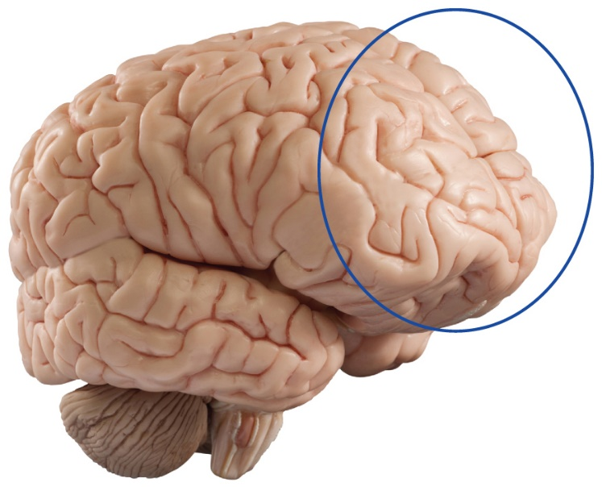
Working the Scientific Literacy Model: Adolescent Risk and Decision Making (2 of 4)
How can science test the link between brain function and decision making in adolescents?
Figure 10.15 Extended Brain Development
The prefrontal cortex (circled in blue) continues to develop through adolescence and into young adulthood.
werbefoto-burger.ch/Fotolia
Notes:
2) How can science test the link between brain function and decision making in adolescents?
i) One study examined how actual brain activity is affected in adolescents who make risky decisions.
a) Brain scans were taken of adolescents while they played a betting game.
b) They could choose between a risky option of betting $6 on stopping at a target with a 25% chance of hitting or a less risky option of betting $1 that the wheel would stop at a target that had a 50% chance of hitting.
c) Those who chose the riskier option had less brain activity in their prefrontal cortex (Figure 10.15).

Slide 46
Working the Scientific Literacy Model: Adolescent Risk and Decision Making (3 of 4)
Can we critically evaluate this explanation for risky decision making?
Still capable of making good decisions
Temperament and personality
Situational factors
Why is this relevant?
Major public health problem
Notes:
1) Can we critically evaluate this explanation for risky decision making?
i) The still-developing prefrontal cortex of adolescents offers a plausible scientific explanation for why they are prone to risk taking and poor decision making.
a) However, they are still capable of making good decisions and accepting blame and taking credit where it is due.
ii) Temperament and personality characteristics are also involved in risk taking and decision making, which vary from person to person, regardless of age.
iii) Situational factors also play a role in whether adolescents take risks (Figure 10.16).
a) For example, teenagers are more likely to take risks in the presence of peers.
2) Why is this relevant?
i) Scholars, parents, and insurance companies regard adolescent risk-taking behaviour as a major public health problem.
ii) Countless hours and public funds have been devoted to implementing programs aimed at steering adolescents toward making better decisions, such as avoiding unprotected sex, smoking, alcohol, and drug use.

Slide 47
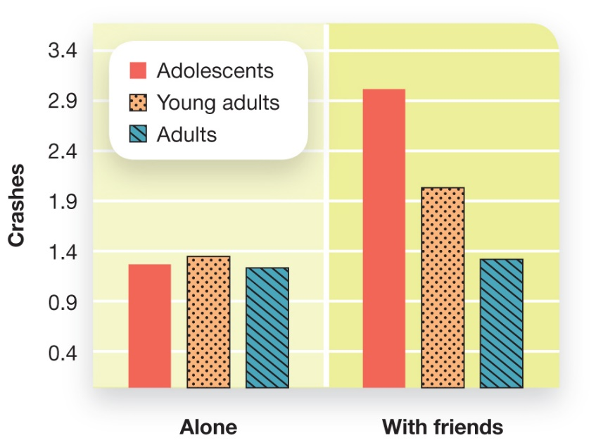
Working the Scientific Literacy Model: Adolescent Risk and Decision Making (4 of 4)
Figure 10.16 What Drives Teenagers to Take Risks?
One key factor in risk taking is simply other teenagers. When teens play a driving video game with other teens, they crash more than when playing the same game alone, and more than adults playing the game (from Steinberg, 2007).
Notes:
1) Can we critically evaluate this explanation for risky decision making?
i) The still-developing prefrontal cortex of adolescents offers a plausible scientific explanation for why they are prone to risk taking and poor decision making.
a) However, they are still capable of making good decisions and accepting blame and taking credit where it is due.
ii) Temperament and personality characteristics are also involved in risk taking and decision making, which vary from person to person, regardless of age.
iii) Situational factors also play a role in whether adolescents take risks (Figure 10.16).
a) For example, teenagers are more likely to take risks in the presence of peers.
2) Why is this relevant?
i) Scholars, parents, and insurance companies regard adolescent risk-taking behaviour as a major public health problem.
ii) Countless hours and public funds have been devoted to implementing programs aimed at steering adolescents toward making better decisions, such as avoiding unprotected sex, smoking, alcohol, and drug use.
Long Description:
The approximate number of crashes in the two scenarios is as follows.
Alone
Adolescents: 1.3
Young adults: 1.4
Adults: 1.2
With friends
Adolescents: 3.0
Young adults: 2.0
Adults: 1.3

Slide 48
Cognitive Development: Moral Reasoning vs. Emotions
Formal operational stage
Abstract thinking
Scientific thinking
Perspective taking
Notes:
1) Cognitive abilities approach their peak between the onset of adolescence and young adulthood.
i) Youths of this age begin thinking abstractly about things not present and about scenarios that are impossible or hypothetical.
a) This is a major advance from concrete thinking of late childhood.
ii) Adolescents also develop the ability and capacity to think scientifically and view problems from multiple perspectives.

Slide 49
Kohlberg’s Moral Development: Learning Right from Wrong (1 of 2)
A trolley is hurtling down the tracks toward a group of five unsuspecting people. You are standing next to a lever that, if pulled, would direct the trolley onto another track, thereby saving the five individuals. However, on the second track stands a single, unsuspecting person, who would be struck by the diverted trolley.
Notes:
1) Children begin to learn right and wrong by observing which behaviours are punished or rewarded.
i) Adolescents come to understand that there can be a lot of space between these two alternatives.
2) Studying moral development traditionally involves posing a dilemma to people of different ages and examining the details of their responses.
i) For example,
A trolley is hurtling down the tracks toward a group of
five unsuspecting people. You are standing next to a lever
that, if pulled, would direct the trolley onto another track,
thereby saving the five individuals. However, on the second
track stands a single, unsuspecting person, who would be
struck by the diverted trolley.
ii) It is not so much your choice, but how and why you made your choice that is of great interests to psychologists.
3) Lawrence Kohlberg identified three stages of moral reasoning (Table 10.5).
i) An adult and child both might chose to flip the switch, but for completely different reasons.
ii) However, Kohlberg’s research is limited in that he only examined males’ moral reasoning.
iii) In addition, many everyday dilemmas are based on emotional reactions versus logical problem solving.
4) It appears that girls reason differently about moral dilemmas than boys do.
i) Females appear to base moral decisions more on caring relationships and less on justice and abstract principles that Kohlberg emphasized.

Slide 50
Kohlberg’s Moral Development: Learning Right from Wrong (2 of 2)
Table 10.5 Kohlberg’s Stages of Moral Reasoning
Stage of Moral Development | Description | Application to Trolley Dilemma
Preconventional morality | Characterized by self-interest in seeking reward or avoiding punishment. Preconventional morality is considered a very basic and egocentric form of moral reasoning. | “I would not flip the trolley track switch because I would get in trouble.”
Conventional morality | Regards social conventions and rules as guides for appropriate moral behaviour. Directives from parents, teachers, and the law are used as guidelines for moral behaviour. | “I would not flip the switch. It is illegal to kill, and if I wilfully intervened I would probably violate the law.”
Postconventional morality | Considers rules and laws as relative. Right and wrong are determined by more abstract principles of justice and rights. | “I would flip the switch. The value of five lives exceeds that of one, so saving them is the right thing to do even if it means I am killing one person who would otherwise not have died.”
Notes:
1) Children begin to learn right and wrong by observing which behaviours are punished or rewarded.
i) Adolescents come to understand that there can be a lot of space between these two alternatives.
2) Studying moral development traditionally involves posing a dilemma to people of different ages and examining the details of their responses.
i) For example,
A trolley is hurtling down the tracks toward a group of
five unsuspecting people. You are standing next to a lever
that, if pulled, would direct the trolley onto another track,
thereby saving the five individuals. However, on the second
track stands a single, unsuspecting person, who would be
struck by the diverted trolley.
ii) It is not so much your choice, but how and why you made your choice that is of great interests to psychologists.
3) Lawrence Kohlberg identified three stages of moral reasoning (Table 10.4).
i) An adult and child both might chose to flip the switch, but for completely different reasons.
ii) However, Kohlberg’s research is limited in that he only examined males’ moral reasoning.
iii) In addition, many everyday dilemmas are based on emotional reactions versus logical problem solving.
4) It appears that girls reason differently about moral dilemmas than boys do.
i) Females appear to base moral decisions more on caring relationships and less on justice and abstract principles that Kohlberg emphasized.

Slide 51
Moral Development
Social intuitionist model
Julie and Steven are brother and sister. They are travelling together in France on summer vacation from college. One night they are staying alone in a cabin near the beach. They decide that it would be interesting and fun if they shared a romantic kiss. At the very least it would be a new experience for each of them. They both enjoy the experience, but they decide not to do it again. They keep that night as a special secret, which makes them feel even closer to each other.
Notes:
5) According to the social intuitionist model of morality, our moral judgments are not guided solely by reason, but also by our emotional, intuitive reactions to a moral dilemma.
i) For example,
Julie and Steven are brother and sister. They are travelling
together in France on summer vacation from college. One
night they are staying alone in a cabin near the beach.
They decide that it would be interesting and fun if they
shared a romantic kiss. At the very least it would be a new
experience for each of them. They both enjoy the experience
but they decide not to do it again. They keep that
night as a special secret, which makes them feel even closer
to each other.
ii) People’s first reaction to this scenario, typically involves their emotional intuition about whether the act was moral.
a) This is often followed by thoughtful and reflective thinking, which often amounts to an after-the-fact attempt to put into words how one feels.

Slide 52
Social Development: Identity and Relationships
Identity (p. 395)
Personal qualities
Social qualities
Future goals
Adolescence identity crisis
Curiosity, questioning, and exploration
Peer groups
Romantic relationships
Notes:
1) A major issue faced by adolescents is the formation of an identity.
Identity (p. 395) is a clear sense of what kind of person you are, what types of people you belong with, and what roles you should play in society.
i) Going back to Erikson’s stages, the primary psychosocial conflict during adolescence through early adulthood (ages 14-24) is identity versus role confusion.
a) During this time, individuals are trying to figure out their personal identities, desired careers, and religious and political orientations.
ii) As identity develops, adolescents tend to describe themselves in terms of personal qualities (“I am a good listener), social qualities (“my family and I are Hindu”), and future goals (“I am going to be an artist”).
2) Adolescents may experience numerous identity crises before they reach young adulthood.
i) An identity crisis involves curiosity, questioning, and exploration of different identities.
a) For example, one month a teenage boy might be into football and lifting weights and the next month he might consider abandoning sports for music.
3) Peer groups
i) Friendships are a priority to most adolescents, and teenagers typically spend more time with peers while gaining independence from their parents.
Friendships take place within a broader social context of small groups or cliques, and the membership and intensity of friendships within a clique are constantly changing
4) Romantic relationships
i) In addition to friendships taking prominence over family, teens’ social lives also begin to revolve around seeking, or being involved in, romantic relationships.
This opens up new worlds of exploring both emotional and physical intimacy.

Slide 53
10.4 Learning Objectives
Know the key terminology concerning adulthood and aging.
Know the key areas of growth experiences by emerging adults.
Understand age-related disorders such as Alzheimer’s disease.
Understand how cognitive abilities change with age.
Apply your attitudes about marriage.
Analyze the stereotype that old age is a time of unhappiness.
Notes:
Know the key terminology concerning adulthood and aging.
People making the transition from adolescence to adulthood face substantial life challenges that contribute to personal growth in three main areas: relationships (i.e., cultivating true intimacy and trust); new possibilities (i.e., exploring what they really want to do with their lives and choosing a compatible path that reflects their interests); and personal strengths (i.e., the skills and competencies that come from successfully facing challenges and learning that "you can do it").
Know the key areas of growth experienced by emerging adults.
People making the transition from adolescence to adulthood face substantial life challenges that contribute to personal growth in three main areas: relationships, new possibilities, and personal strengths.
Understand age-related disorders such as Alzheimer’s disease.
Alzheimer’s disease is a form of dementia that is characterized by significant decline in memory, cognition, and eventually personality and basic bodily functioning. It is probably caused by two different brain abnormalities—the buildup of proteins that clump together in the spaces between neurons, plus the buildup of a protein that creates tangles within nerve cells.
Understand how cognitive abilities change with age.
Aging adults typically experience a general decline in cognitive abilities, especially those related to fluid intelligence, such as working memory. However, older adults also develop compensatory strategies that enable them to remain highly functional in their daily lives, despite their slow decline in processing capability
Apply your attitudes about marriage.
Improving communication in relationships requires being wary of the "Four Horseman of the Apocalypse" and learning to fix those destructive communication patterns.
Analyze the stereotype that old age is a time of unhappiness.
Research shows that older adults do face issues that might lead to unhappiness—health problems, loss of loved ones, reductions in personal freedom. However, such challenges often lead to growth and a deepened appreciation for life and other people; the result is that many older people become skilled at focusing on the positives of life and paying less attention to the negatives, leading to an increase in life satisfaction, not a decrease

Slide 54
Physical Changes in Adulthood
Age brackets:
Young adulthood: 18-40 years
Middle adulthood: 40-65 years
Older adulthood: 65 years and onward
Menopause (p. 399)
Notes:
1) Because there is no true biological or psychological marker that signals adulthood, psychologists who study the entire life span divide adulthood based on age brackets:
i) Young adulthood: 18-40 years
ii) Middle adulthood: 40-65 years
iii) Older adulthood: 65 years and onward
Physical Changes in Adulthood
1) The most obvious age-related physical changes in adulthood typically appear during middle adulthood.
i) These include an increased likelihood of weight gain, thinning and graying of the hair, and some declines in sensory abilities, such as hearing and sight.
ii) Women around the age of 50 experience menopause (p. 399): the termination of the menstrual cycle and reproductive ability.
a) This reduction of estrogen hormone can lead to hot flashes, reduced sex drive, and mood swings.
iii) Men experience lower testosterone and sex drive in middle age but do not have the drastic symptoms associated with menopause.

Slide 55
Psychosocial Development Across the Lifespan (2 of 2)
Ages 25 to 40
Separate from parents
Work on intimate relationships
Failure can result in isolation
Ages 45 to 65
Producing something of value
Work and/or family
Ages 65+
Reflect on life of fulfillment (or not)
Notes:
1) According to Erikson, the major challenge spanning years 25 through 40 is intimacy versus isolation.
i) Young adults separate from their parents, and become challenged with cultivating caring, compassionate, and intimate relationships.
a) Failure to do so can result in isolation or entering into a relationship that lacks intimacy and sharing.
2) The next stage, generativity versus stagnation (ages 45 to 65 years), is characterized by the pursuit to produce something of value for future generations.
i) This can include accomplishments at work and/or with family.
3) Erikson’s final stage is ego integrity versus despair (ages 65+).
i) The individual contemplates whether s/he has lived a full life and fulfilled major accomplishments.
a) If not, the person looks back at disappointments and failures.

Slide 56
Love and Marriage
Most adults pursue some kind of long-term relationship
Marriage associated with longer life, happiness
Gottman
Conflict and communication
“Four horsemen of the Apocalypse”
Notes:
1) Although not all long-term committed relationships proceed to marriage, it remains the norm, The proportion of people who marry varies by societal trends and civil arrangement options (e.g., common-law marriage). Regardless, most adults pursue some kind of long-term relationship.
2) Consistent with Erikson's theorizing, being able to establish a committed, long-term relationship seems to be good for people, although of course not in all cases, such as abusive relationships. On average, however, being married is associated with greater health, longer life and increased happiness.
3) Many different factors can lead to divorce, but decades of behavioural studies of relationships have shown that a critical factor is how well couples are able to communicate, particularly during conflict. Dr. John Gottman has identified what he calls the “Four Horseman of the Apocalypse,” four communication patterns that are toxic to relationships.
i) Criticism
ii) Defensiveness
iii) Contempt
iv) Stonewalling

Slide 57
Parenting
Shift in identity, lifestyle
Children affect marriage
Empty nest myth
Notes:
1) As people become parents, they often experience a major shift in identity; not only can they kiss goodbye to sleeping in on Saturday mornings, but they change their whole way of looking at life.
2) Marriages can be stabilized as parents pull together “for the sake of the kids,” it also exacts a cost; within the first two years of having children, parents typically report that marital satisfaction declines. Marital satisfaction is usually highest before the birth of the first child, then is reduced until the children enter school, and not uncommonly, until the children actually leave home as young adults themselves.
3) The notion of parents suffering in their “empty nest” once their children leave home, is largely a myth. Although some parents may take a fresh look at their relationship once it’s just the two of them again and discover they really don’t have anything in common anymore, the general trend is the opposite; married older adults are just as likely to report being “very satisfied” with marriage as are newlyweds.

Slide 58
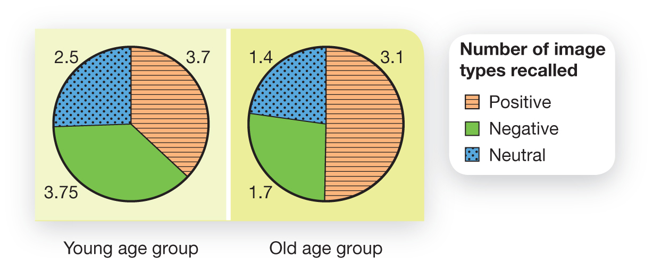
Late Adulthood: Happiness and Relationships (1 of 2)
Socioemotional selectivity theory (p. 402)
Figure 10.18 Emotion, Memory, and Aging
Younger people have superior memory for whether they have seen positive, negative, or neutral pictures compared with older people. However, notice that younger people remember positive and negative pictures equally, whereas older people are more likely to remember positive pictures (Charles et al., 2003).
Source: Data from Carstensen, L. L., & Mikels, J. A. (2005). At the intersection of emotion and cognition: Aging and the positivity effect. Current Directions in Psychological Science, 14(3) 117—121.
Notes:
1) Developmental psychologists describe personal development in late adulthood through the lens of socioemotional selectivity theory (p. 402), which describes how older people have learned to select for themselves more positive and nourishing experiences. Older people seem better able to pay more attention to positive experiences, and to tend to take part in activities that emphasize positive emotions and sharing meaningful connections with others.
2) Healthy older adults are no more likely to become depressed than are younger people.
i) As long as basic emotional and social needs are met, old age can be a very joyous time.
ii) Older people are generally more optimistic than young adults and adolescents.
a) They are better at dealing with adversity and negative emotional experiences.
3) Although there are a number of reasons why older adults may experience depression (e.g., loss of loved ones, illness, reality of dying), research has found that negative emotions decline with age while positive emotions increase in frequency.
i) There are a number of reasons why emotional well-being might increase with age.
a) With wisdom and experience come the ability to avoid situations that may elicit negative emotions.
b) Older people are better at putting themselves in situations that elicit positive emotions.
c) Older people are more likely to set goals that emphasize positive emotional and meaningful experiences.
Long Description:
The number of images recalled is as follows.
Young age group
Positive: 3.7
Negative: 3.75
Neutral: 2.5
Old age group
Positive: 3.1
Negative: 1.7
Neutral: 1.4

Slide 59
PSYCH @ The Driver’s Seat
Driving skills and age
UFOV Speed of Processing training
Computer-based
Decreases accident risk
Notes:
1) Research has shown that the cognitive and physical changes in old age may take a toll on driving skills.
2) To address this problem, psychologist Karlene Ball developed an intervention call the Useful Field of View (UFOV) Speed of Processing training.
i) These are a computer-based training exercises to increase the portion of the visual field that adults can quickly process and respond to.
ii) Records from several states have shown that those who complete the UFOV training were half as likely to have an accident during the study period.

Slide 60
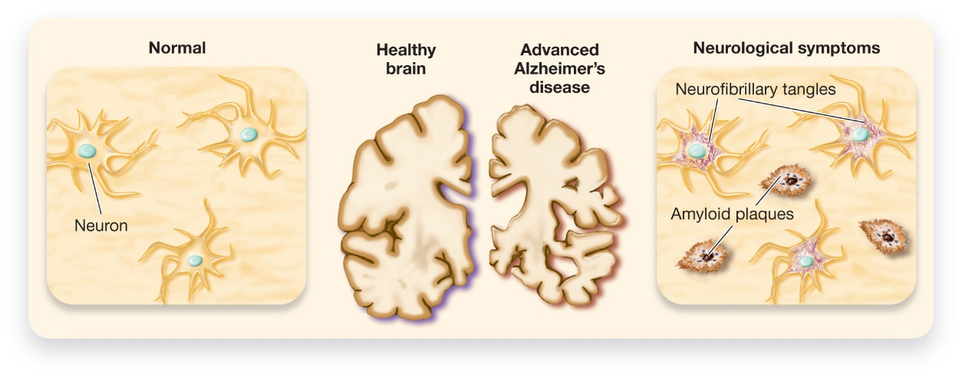
Physical Changes
Figure 10.19 How Alzheimer’s Disease Affects the Brain
Advanced Alzheimer’s disease is marked by significant loss of both grey and white matter throughout the brain. The brain of a person with Alzheimer’s disease typically has a large buildup of a protein called beta-amyloid, which kills nerve cells. Also, tau proteins, which maintain the structure of nerve cells, are often found to be defective in the Alzheimer’s brain, resulting in neurofibrillary tangles.
Retrieved from www.nia.nih.gov/sites/default/files/alzheimers_disease_unraveling_the_mystery_2.pdf
Notes:
1) The brain also goes through age-related physical changes.
i) Volume of white and grey matter of the cerebral cortex, as well as the memory-processing hippocampus, are reduced.
ii) Aging also puts people at a greater risk for developing neurodegenerative conditions.
a) These are characterized by significant loss of nerve cells and nervous system functioning.
Dementia (p. 403) refers to a set of symptoms including mild to severe disruption of mental functioning, memory loss, disorientation, poor judgment, and decision making.
iii) Approximately 14% of people older than 71 years of age have dementia.
a) 10% of this group have a type of dementia called Alzheimer’s disease (Figure 10.19).
Alzheimer’s disease (p. 403) is a degenerative and terminal condition resulting in severe damage of the entire brain.
2) Alzheimer’s disease rarely appears before age 60, and it usually lasts 7 to 10 years from onset to death (although some have lived much longer).
i) Early symptoms include forgetfulness of recent events, poor judgment, and some mood and personality changes.
ii) As it progresses, people struggle to recognize family members, have frequent memory loss, and experience confusion.
iii) In the most advanced stages, individuals may fail to recognize themselves and develop difficulty with basic bodily processes (e.g., swallowing and bladder control).
3) Alzheimer’s disease is thought to be due to the buildup of certain proteins, often referred to as plaques, that clump together in the spaces between neurons.
i) This interrupts normal activity.
ii) Another protein forms neurofibrillary tangles within nerve cells, which severely disrupts their structural integrity and functioning.
Long Description:
The illustration shows the following.
Healthy: Neurons are healthy. The cross section of the brain shows clear edges.
Affected by Advanced Alzheimer’s disease: Neurons show pink-coloured masses labelled “Neurofibrillary tangles.” The area between the neurons shows eye-shaped masses labelled “Amyloid plaques” with a brown dot in them. The cross section of the brain shows edges that have been eaten away.

Slide 61
Working the Scientific Literacy Model: Aging and Cognitive Change (1 of 3)
What do we know about cognitive abilities?
Fluid intelligence declines
Crystalized intelligence remains largely intact
How can science explain age-related differences in cognitive abilities?
Activation of brain areas
Notes:
1) What do we know about cognitive abilities?
i) Memory abilities change over the course of the life span.
ii) Fluid intelligence peaks during young adulthood and proceeds to decline, whereas crystallized intelligence remains largely intact (Module 9.2).
a) For example, your grandparent probably has no problem solving a crossword puzzle, which requires the use of accumulated knowledge.
2) How can science explain age-related differences in cognitive abilities?
i) Older adults sometimes use ineffective cognitive strategies, leading to lower levels of activation of relevant brain areas. However, by giving older adults strategies to help them more deeply encode the information, older adults were able to activate these brain areas to a greater extent, thus improving their memories for the information.
ii) Older brains show more general, non-specific brain activation for a given task. They may do so either because they are compensating for deficits in one area by recruiting other areas, or possibly because they are less capable of limiting activation to the appropriate, specialized neural areas.

Slide 62
Working the Scientific Literacy Model: Aging and Cognitive Change (2 of 3)
Can we critically evaluate our assumptions about age-related cognitive changes?
Too simplistic to say memory declines
Many different types of memory
Compensation
Why is this relevant?
Control over how one ages
Notes:
1) Can we critically evaluate our assumptions about age-related cognitive changes?
i) It is too simplistic to say that memory declines with age—it depends on the type of memory system (STM or LTM) and on the individual.
ii) There are many types of memory:
a) Episodic = events
b) Semantic = meaning and structure of facts
c) Procedural = motor skills.
iii) Episodic memory and working memory decline at a more rapid rate than other types of memory in healthy, aging adults.
a) However, older people remained skilled at remembering facts and ways to operate devices.
iv) Older adults learn to compensate for their reduced raw cognitive power by using their abilities more skillfully.
2) Why is this relevant?
i) Although some declines in mental abilities are expected with age, people have a great deal of control over how they age.
ii) Research has found that older people who choose to engage in cognitive tasks are mentally sharper and more satisfied with their mental abilities than those who feel they cannot overcome the effects of aging.
a) One key appears to be engaging in activities that you like (such as socializing, gardening, etc.) versus those people expect you to engage in (e.g., crossword puzzles).
iii) These findings have an influence in how we interact with senior citizens at home and in retirement facilities.

Slide 63

Working the Scientific Literacy Model: Aging and Cognitive Change (3 of 3)
Figure 10.20 Memory and Aging
Several types of memory systems exist, not all of which are equally affected by age. An older person’s ability to remember events, such as words that appeared on a list (episodic memory), is more likely to decline than his or her memory for facts and concepts (semantic memory).
Notes:
1) Can we critically evaluate our assumptions about age-related cognitive changes?
i) It is too simplistic to say that memory declines with age—it depends on the type of memory system (STM or LTM) and on the individual.
ii) There are many types of memory:
a) Episodic = events
b) Semantic = meaning and structure of facts
c) Procedural = motor skills.
iii) Episodic memory and working memory decline at a more rapid rate than other types of memory in healthy, aging adults.
a) However, older people remained skilled at remembering facts and ways to operate devices.
iv) Older adults learn to compensate for their reduced raw cognitive power by using their abilities more skillfully.
2) Why is this relevant?
i) Although some declines in mental abilities are expected with age, people have a great deal of control over how they age.
ii) Research has found that older people who choose to engage in cognitive tasks are mentally sharper and more satisfied with their mental abilities than those who feel they cannot overcome the effects of aging.
a) One key appears to be engaging in activities that you like (such as socializing, gardening, etc.) versus those people expect you to engage in (e.g., crossword puzzles).
iii) These findings have an influence in how we interact with senior citizens at home and in retirement facilities.

